Slide 1
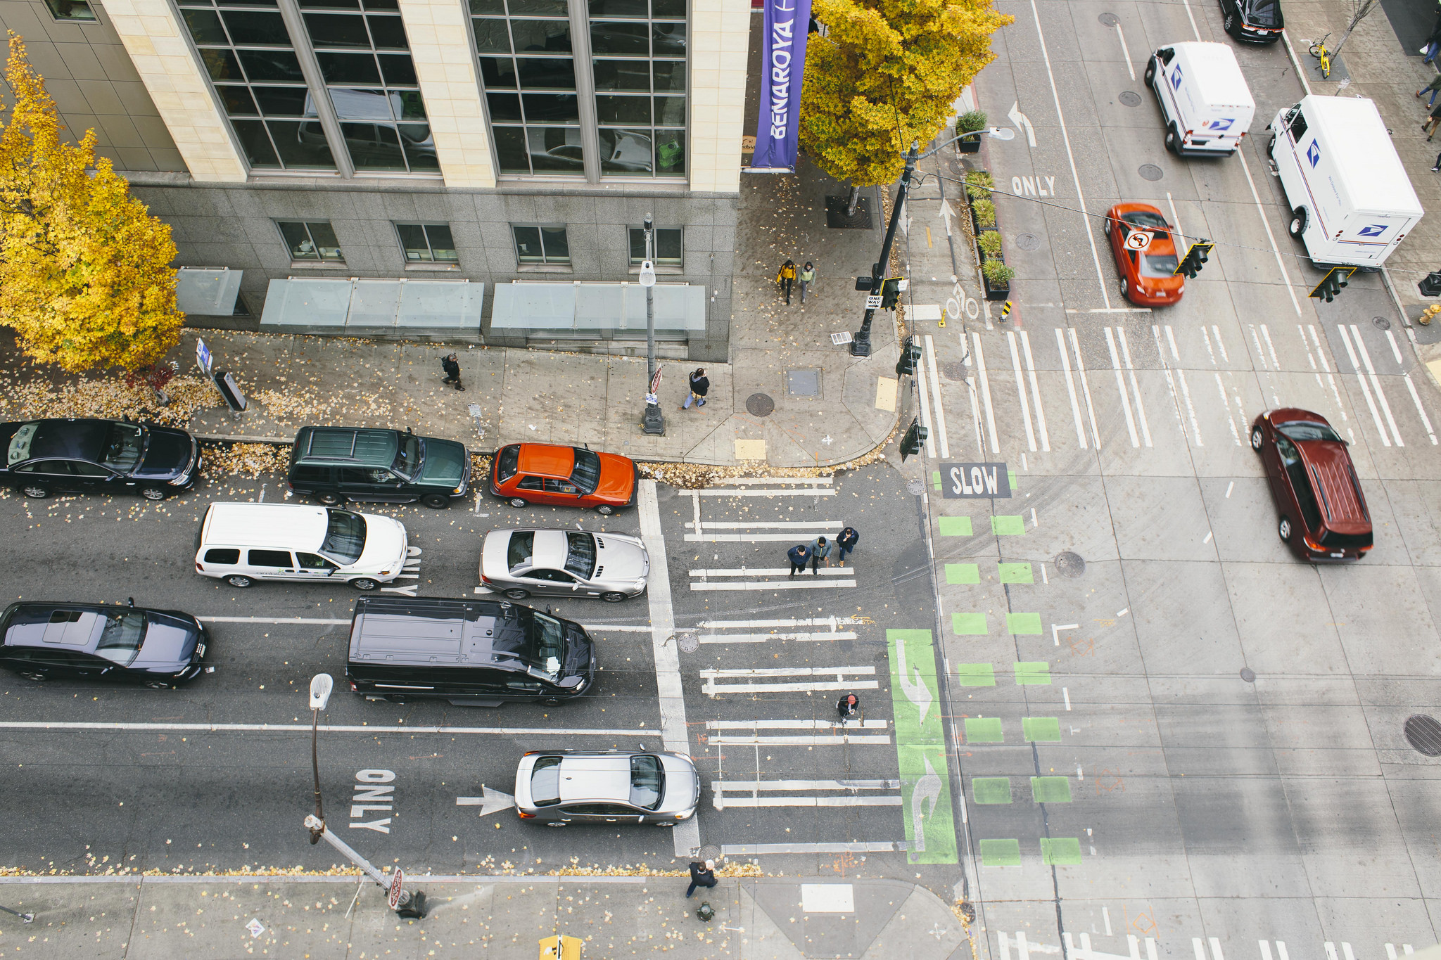
SDOT Annual WMBE Update

Slide 2
SDOT WMBE Program
  Promotes Inclusion: Promotes women and minority owned businesses participation on department contracts and evaluates compliance.
    Eliminates internal barriers through policy: Fosters internal support for the program through training and policies.
    Shares resources and information with firms: Facilitates outreach within the community.
Notes:
Includes various strategies:
-scoping projects to make attainable for WMBEs (unbundling-capacity)
-once projects are known, making sure community knows about them so they have opportunity to align themselves with our needs
-after projects released – ensuring we adhere to WMBE inclusion goals through compliance, working with firms
-after projects are closed, using evaluation tools we evaluate progress and potential impact for future procurements

Slide 3
SDOT 2018 Spend

Slide 4
SDOT in Context
In 2018 SDOT accounted for 62M in Consultant & Purchasing Spend out of the 579M Consultant & Purchasing Total for City of Seattle

Slide 5
SDOT WMBE Goals vs. Actuals
Notes:
Purchasing: $4.4M
Consulting: $14.9M

Slide 6
SDOT 2018 WMBE Outcomes
Consulting
14.9M WMBE
Goal 10%
Actual 11%
Goal 15%
Actual 19%
Purchasing
4.4M WMBE
19.3M
Paid to WMBE Firms in 2018

Slide 7
SDOT WMBE SPEND

Slide 8
Monitoring Subconsultant Commitments
Implemented On-Line Contract Compliance: B2Gnow
Conduct Monthly Audits
  Payment Amounts
  Prompt Payment (90%)
Approximately 50 active Monitored Contracts,
  6.2M in Subconsultant Payments
WBE
2.4M
MBE
1.2M
3.6M Sub-Dollars
paid in 2018

Slide 9
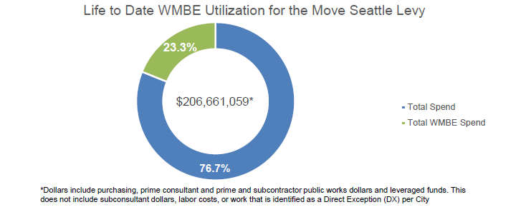
Move Seattle Levy WMBE Goal (2016-2018)
The Move Seattle Levy also features a 23% WMBE Goal for all purchasing, prime consultant and Public Works contract dollars associated with the Levy.
From 2016-2018, the Move Seattle Levy has a 23.3% WMBE utilization, or approximately $48M to Women- and Minority-Owned Businesses.
Notes:
Approved by voters in 2015, the 9-year, $930 million Levy to Move Seattle provides funding to improve safety for all travelers, maintain our streets and bridges, and invest in reliable, affordable travel options for a growing city.
The levy provides 24% of the City’s 2019 Adopted Department of Transportation budget and replaced the 9-year, $356M Bridging the Gap levy approved by voters in 2006. SDOT is organizing its daily work around the Department’s core values of a safe, interconnected, vibrant, affordable and innovative city. The levy aims to take care of the basics while also investing in the future with improvements to move more people and goods in and around a growing Seattle.
Through 2018 – MSL has 23% WMBE Utilization which is a total of $48,139,290 to Women- and Minority-Owned Businesses.
Contract dollars include spend to Public Works subcontractors and leveraged funds but does not include subconsultant dollars in line with City policy, labor costs, or work that is identified as Direct Exception (DX) according to City Purchasing Rules
2016: 20% WMBE Utilization
2017: 22% WMBE Utilization
2018: 27% WMBE Utilization

Slide 10
Overview: Prompt Payment
Prompt Payment at a Glance
208 Roster Invoices Processes 1523 Consultant Contract Invoices Processed 1731 Total Invoices Processed
City of Seattle Prompt Payment Policy
  Department Goals
100% SDOT Prompt Payment Goal in 2018
90% SDOT Invoices paid within 30 days

Slide 11
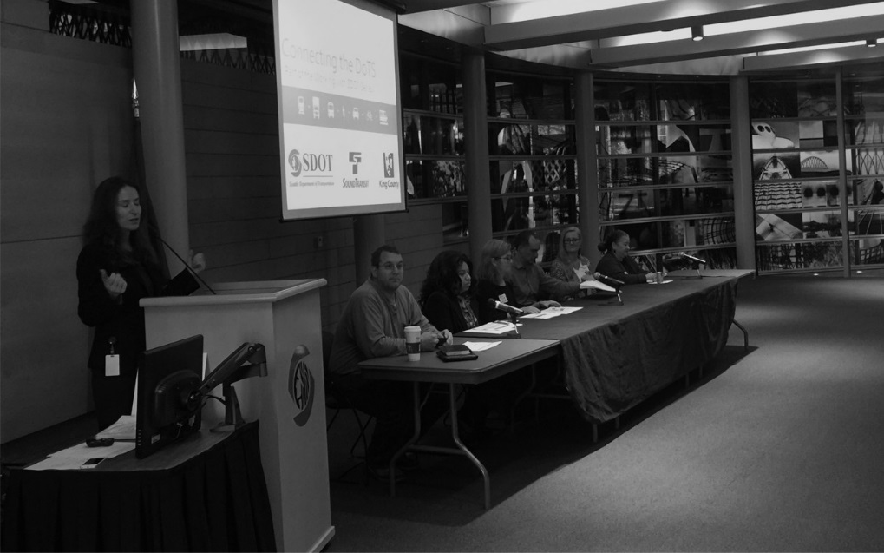
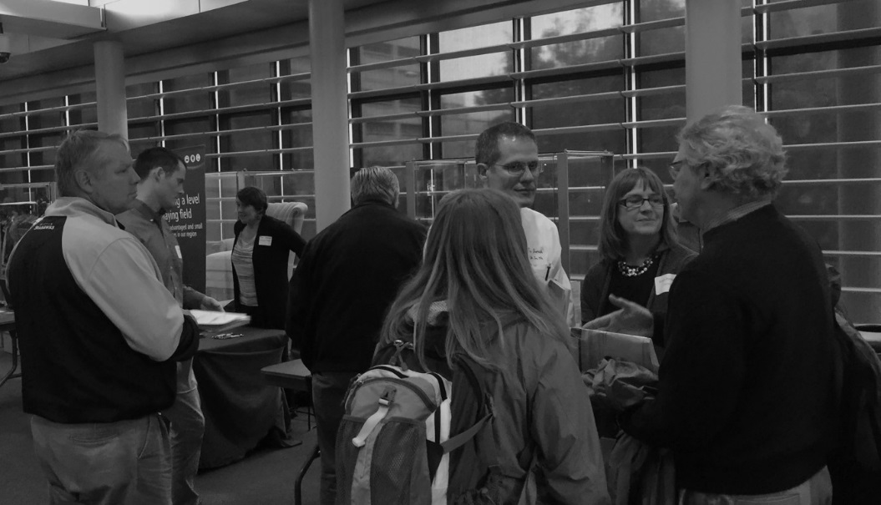
Overview:
2018 SDOT-Hosted Outreach
Working With SDOT: Move Seattle 6/14
  110 Attendees
Working With SDOT: Ready to Prime 10/18
  101 Attendees

Slide 12
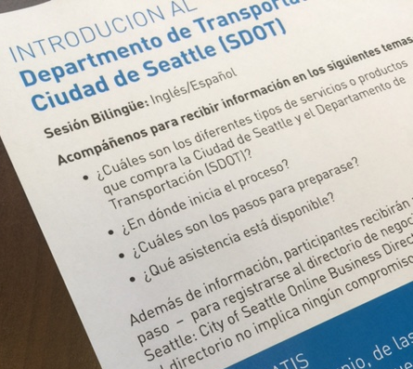
Overview: 2018 Immigrant, Refugee, Micro, Emerging Business Outreach
2018 Intro to SDOT Workshops
  December 11, 2018
  (Spanish)
  December 12, 2018
  (English/Spanish)
Sharing Information on Working with SDOT & Hands-on Workshops
  Understanding contracting with the City
  How to prepare; step-by-step OBD Registration
  Who can help

Slide 13

Overview: Internal Outreach:
WMBE Advocate Series (Spring & Fall)
Renewals: 24/69
24
New WMBE Advocates: 11
10
80 Total SDOT WMBE Advocates
Notes:
Spring & Fall Sessions

Slide 14
SDOT 2019 Plan at a Glance

Slide 15
SDOT WMBE Initiatives 2019
Metrics, Data
Outreach
Trainings
Increase Consultant Goal to 30%
Advance Notice of Contracts
WMBE Advocate
Increase Purchasing Goal to 19%
Working With SDOT Spring, Fall
WMBE Advocate, Primes Pilot
Move Seattle
WMBE Goal 23%
Workshops: Immigrant, Refugee, Emerging, Small Business
Annual Report
Subconsultant Tracking
Prompt Payment 100% Goal

Slide 16
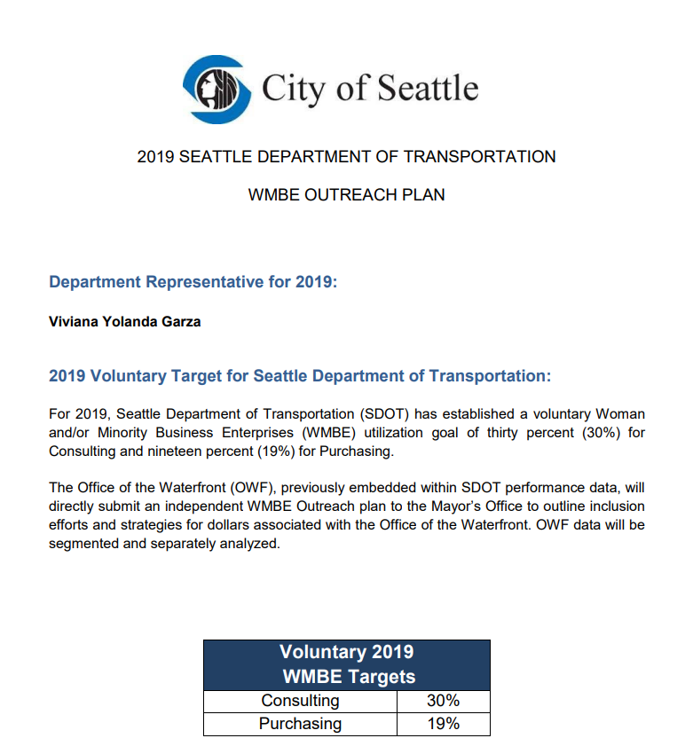
SDOT WMBE Outreach Plan
  Consulting Goal
  Purchasing Goal
  Inclusion Strategies
Notes:
Internal & External Strategies
New Policies: Consultant
-Contract Request Form
-Pre-Submittal
-Scoring
-WMBE Impact Forms and Justification Forms
New Policies: Purchasing Contracts
-Purchasing Form pilot
-Internal Request Form sign-off
-Blanket Request Form sign-off
-Sole Source Review
New Policies: Tracking & Reporting
-Requirements for reporting
-Electronic Invoice tracking
-Compliance Report
Networking Events, Relationship Building
Coordination with Other Departments: Strong WMBE focus in Mayor’s Office, FAS, and Capital Departments

Slide 17


Questions?
viviana.garza@seattle.gov | (206) 684-5188
www.seattle.gov/transportation/oeei-wmbe
www.seattle.gov/transportation

